Slide 1


Extreme-WJLD submission to
JD AI Fashion Challenge
刘三元
王师广
程建
杜鑫
罗韵

Slide 2
AI
Competition description
How to judge the styles of clothes ?
we concentrate on the following aspects to improve the recognition performance:
1: Data argumentation
2: Transfer learning
3: Model fusion
4: The style relationship
Notes:
我们针对的行业：监控行业

Slide 3
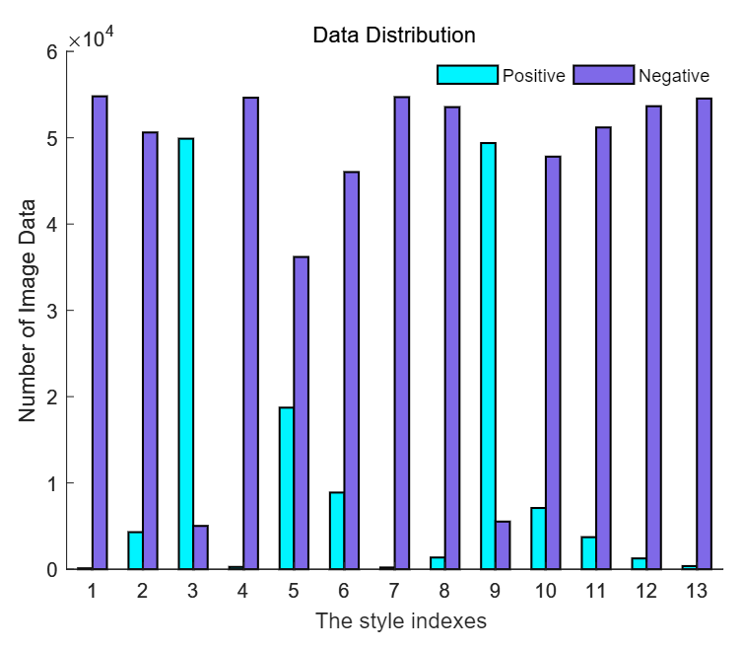
AI
Challenges
Imbalance data distribution
Distribution of the training and validation dataset. It is obviously shown that the class distribution is seriously imbalance. Taking style index 1(运动) as example, there are 104 positive samples while 54804 negative samples in the dataset.
Notes:
我们针对的行业：监控行业

Slide 4
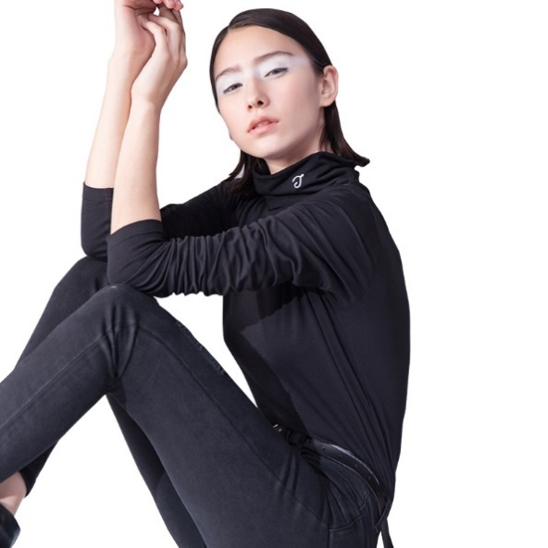
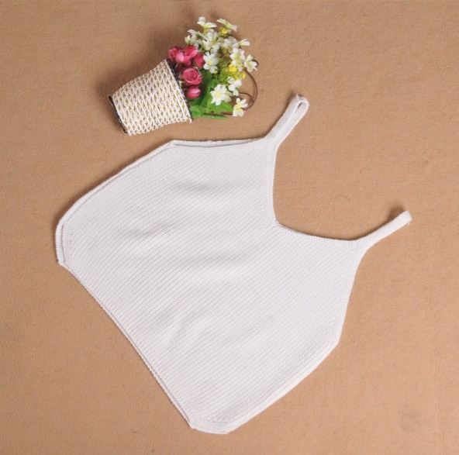

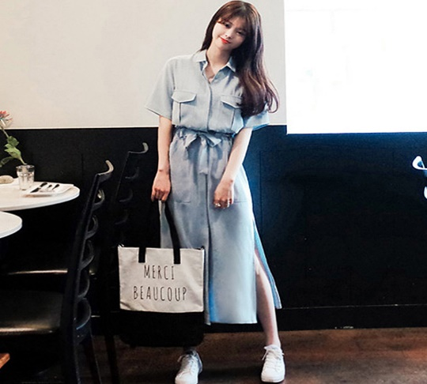
AI
Challenges
Posture
Noise sample
Background
Error labeling
(not belong to Sports)
Notes:
我们针对的行业：监控行业

Slide 5
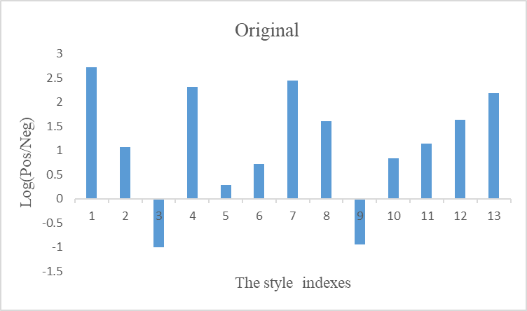
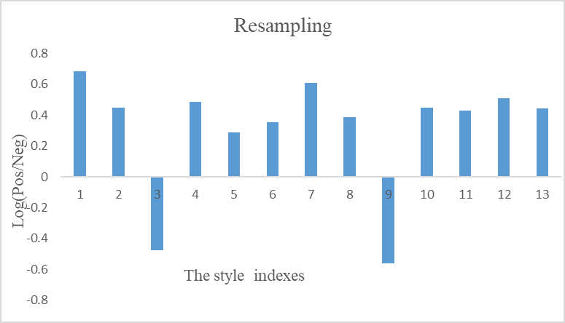
AI
Data argumentation
Resampling the training set
To avoid over-fitting, we resampled the training set to make sure each training batch contains proper positive samples. Moreover, we undersampled negative samples for classes 1, 2, 4, 7, 8, 10, 11, 12, 13 and kept the original proportion for classes 3, 5, 6, 9. The core idea of this opertion is trying to make a balance on improving the pos-neg proportion and maintaining the original data distribution.
Notes:
我们针对的行业：监控行业

Slide 6
AI
Data argumentation
Three ways for data argumentation
Notes:
我们针对的行业：监控行业

Slide 7
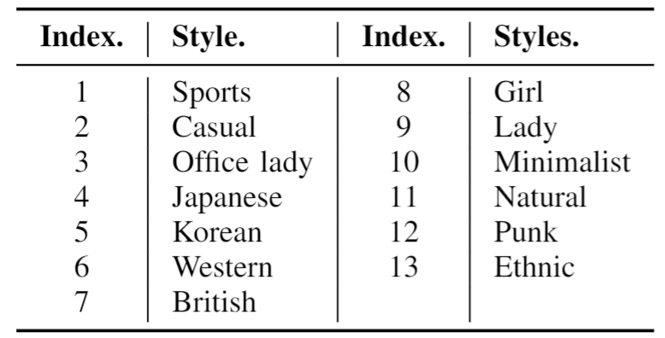
AI
Network architecture
Summary of the 13 style indexes provided by the JDAIfashion dataset.

Slide 8
AI
Network architecture
Comparison of stacking and linear blending method.

Slide 9
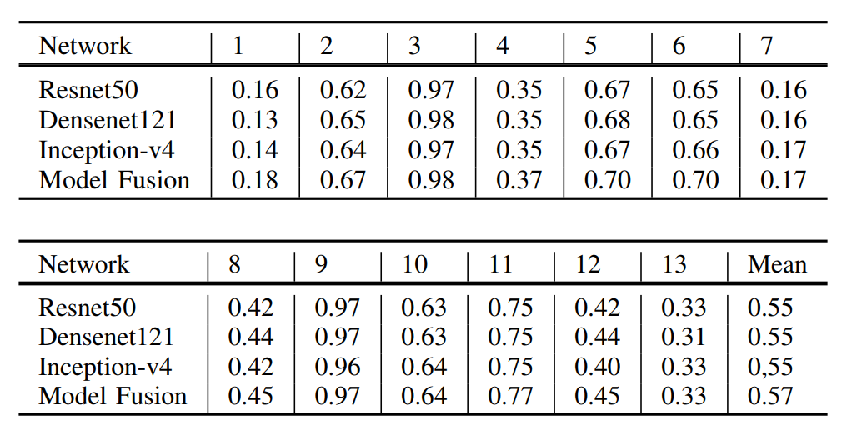
AI
Network architecture
The base model and linear blending method result

Slide 10
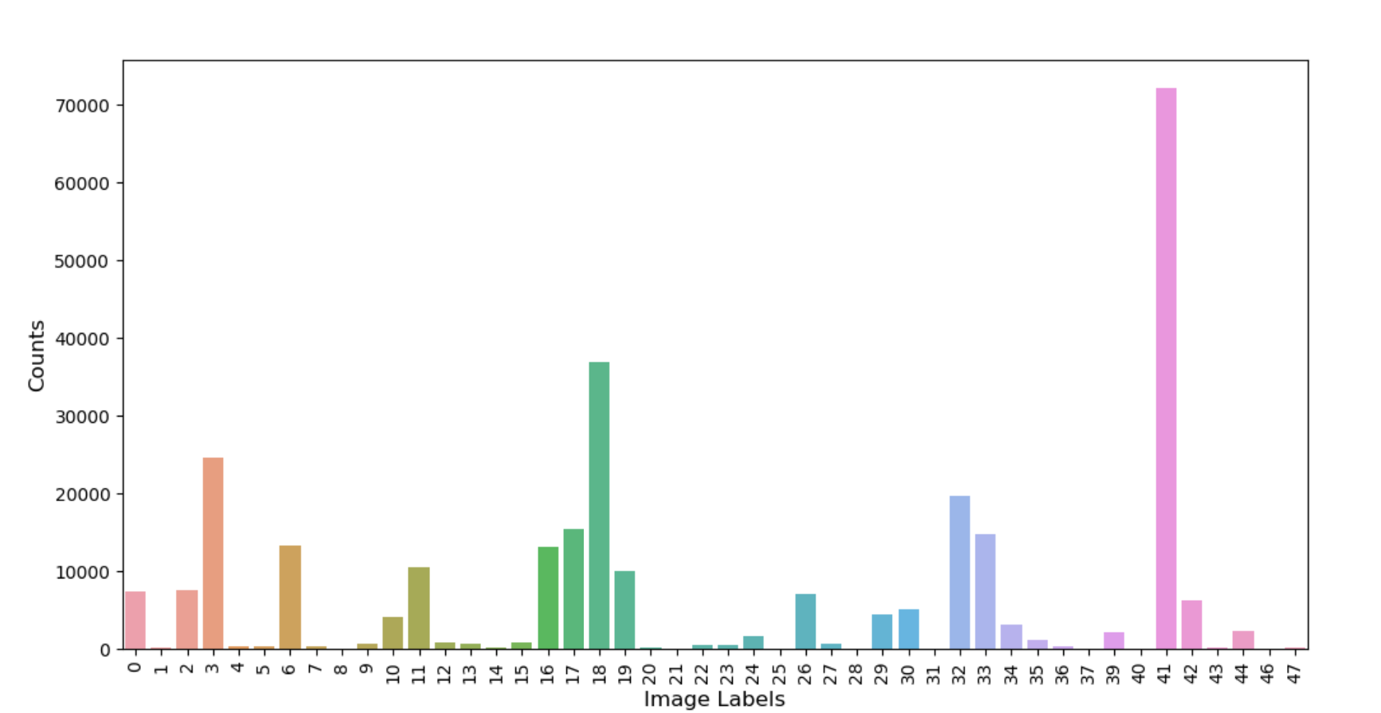
AI
Transfer learning
Since there is a huge gap between ImageNet dataset and JDAIfashion dataset, using ImageNet pretrained model to initialize the weights to help the style recognition may get sub-opt. Hence, we pre-train our base model on DeepFashion dataset, which is a big clothing fashion dataset and have more closely data distribution with JDAIfashion dataset.
Notes:
我们针对的行业：监控行业

Slide 11
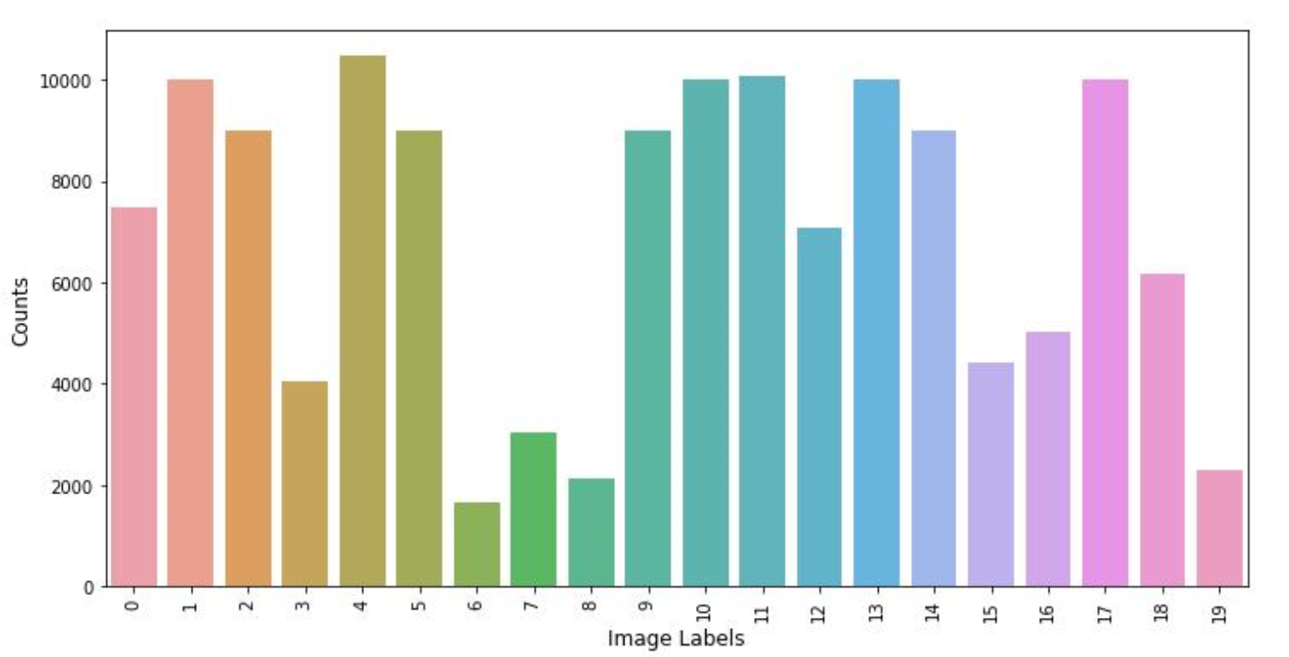
AI
Transfer learning
DeepFashion contains over 800,000 diverse fashion images ranging from well-posed shop images to unconstrained consumer photos. Each image in this dataset is labeled with around 50 categories, 1000 descriptive attributes, bounding box and clothing landmarks. Our pre-training task concentrates on classifying 50 clothes attributes. To get better pre-trained model, we cleaned the dataset and selected 20 attributes with more balanced data distribution.
Notes:
我们针对的行业：监控行业

Slide 12
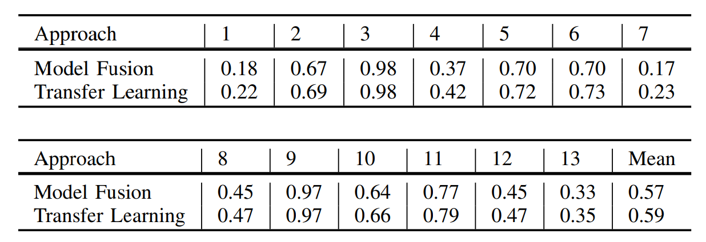
AI
Transfer learning
Performance of using transfer learning for different styles.

Slide 13
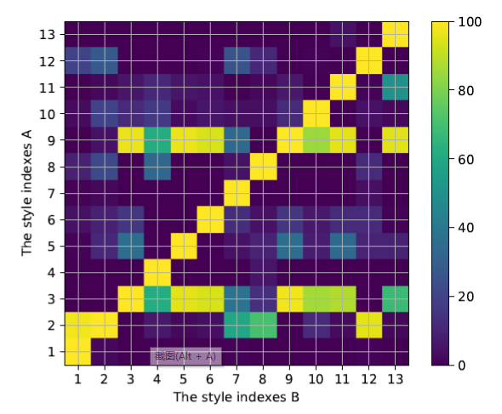
AI
Styles relationship
The conditional probability of style index A when style index B happened. The indexes are declared in Table I. For example, if the clothes belongs to style index 1 (Sports), it may belongs to style index 2 (Casual) with a probability of 95%.

Slide 14
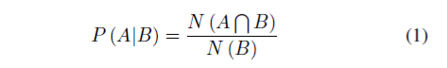
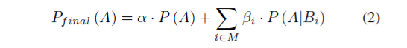
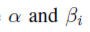
AI
Styles relationship
We analyzed the conditional probability of the given labels with Eqn.1.
Where means the number of images simultaneously belonging to style A and B. N (B) means the number of images belonging to style B. Since we have processed each style individually, we applied the styles relationship (conditional probability) using Eqn.2.
where are the hyper-parameters to balance the contribution of styles relationship. P (A) means the probability calculated by our convolutional neural network. M is the candidate set that our network predict to be positive If the network predicts all the styles as positive with confidence score 0, then the final confidence score of style A is:

Slide 15
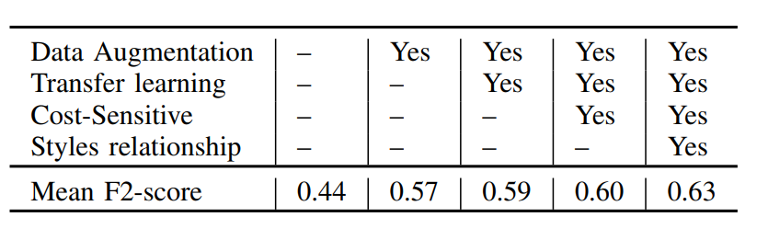
AI
Experiment result
We adopted cross-validation method to evaluate the individual models and the fusion results. Specifically, we split 43926 images for training and 10981 for validation.

Slide 16
AI
CONCLUSION
In this paper, we introduce our proposed method for clothing style classification in JD AI Fashion-Challenge. Our method dealt with the problem from the aspects of data argumentation, network structure, transfer learning and cost sensitive learning. Besides, we investigated the styles relationship for the post processing. With the proposed approach, we achieved 0:6524 F2-score on the testing set, which is the 3rd place on the leaderboard.

Slide 17
END
THANKS！

